Slide 1


Labeled Tweets of @realDonaldTrump
Twitter Account
Presented By:
Sivakanesan Dhanushkanda
PhD Student
Department of Computer Science
Old Dominion University, Norfolk, Virginia
@siva_skanda
Created as a course requirement for CS895 Web Archiving Forensics (by Dr. Michael L. Nelson), Fall 2022

Slide 2
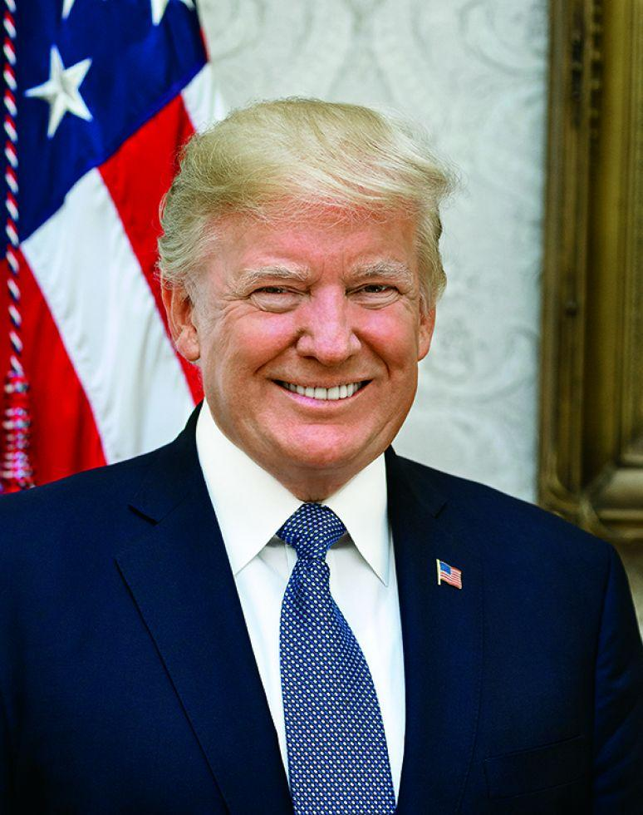
The 45th President of the United States of America’ personal Twitter account (@realDonaldTrump)
It was a popular on account on Twitter
Banned on the 8th of January 2021 “due to the risk of further incitement of violence”[1]
On Nov 2022, he announced his candidacy for the Republican nomination in the 2024 presidential election.
Stats
59,553 Tweets and Retweets (46,919 Tweets, 12,634 RTs)
87.8 M Followers (49 Following)
389,842,552 Retweets received
1,659,180,779 Likes received
Opened his Twitter account on March 18th 2009
Sent his first Tweet on May 4th 2009
Twitter for iPhone Favorite tool to tweet (17,260 tweets sent)
Most retweeted tweet (416,342 retweets): “Tonight, @FLOTUS and I tested positive for COVID-19. We will begin our quarantine and recovery process immediately. We will get through this TOGETHER!” on October 11th 2020
Last tweet sent: “To all of those who have asked, I will not be going to the Inauguration on January 20th.” on January, 8th 2021
https://bookstore.gpo.gov/sites/default/files/styles/product_page_image/public/covers/potus2_0.jpg?itok=jEIslQZ1
[1] https://blog.twitter.com/en_us/topics/company/2020/suspension
https://www.tweetbinder.com/blog/trump-twitter/

Slide 3
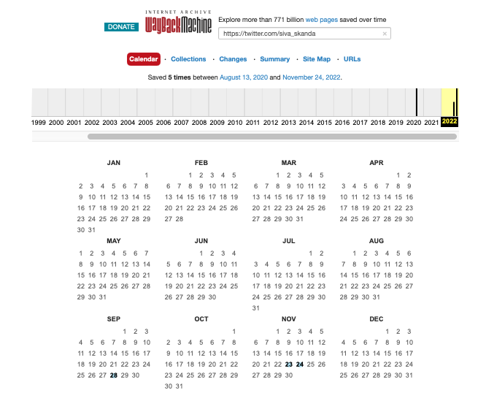
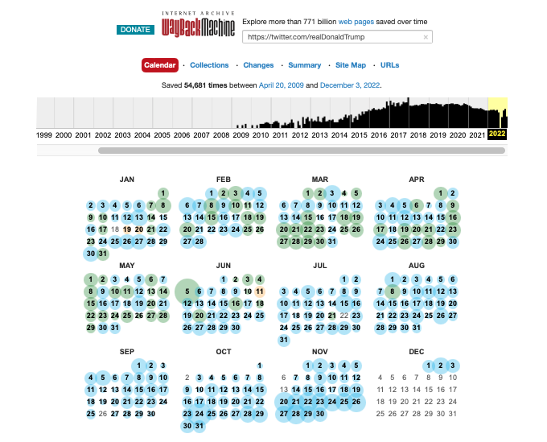
@realDonaldTrump and @siva_skanda Are Poles Apart
in the Internet Archive
https://web.archive.org/web/20220701000000*/https://twitter.com/siva_skanda
https://web.archive.org/web/20220701000000*/https://twitter.com/realDonaldTrump

Slide 4
Twitter Started Adding Labels to Tweets
Twitter added fact-check labels to two tweets by @realDonaldTrump
Twitter added “Violated Twitter Rules” labels
June 1
May 26
Late August
Twitter changed its UI
https://blog.twitter.com/en_us/topics/product/2020/updating-our-approach-to-misleading-information

Slide 5
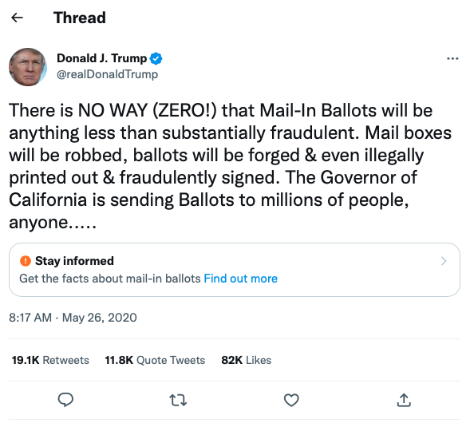
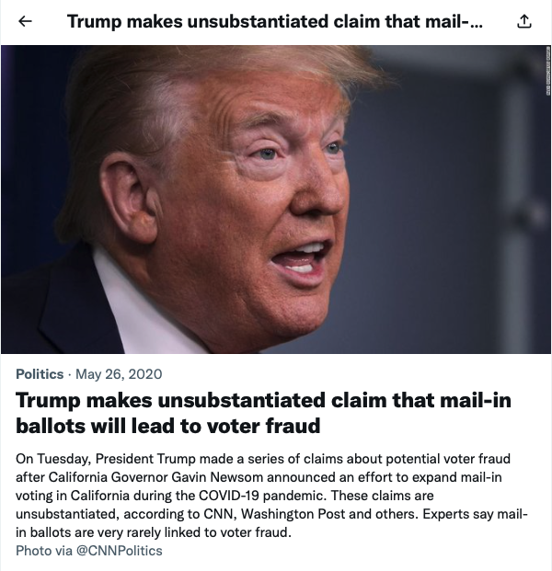
Fact-Check Label
https://twitter.com/realDonaldTrump/status/1265255835124539392
https://twitter.com/i/events/1265330601034256384

Slide 6
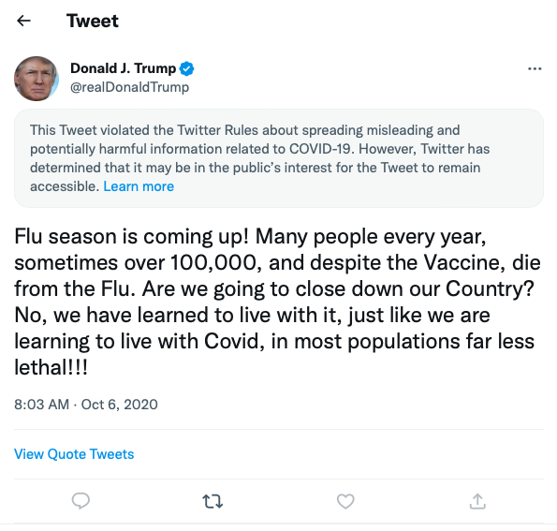

Violated Twitter Rules Label
https://blog.twitter.com/en_us/topics/company/2020/covid-19
https://twitter.com/realDonaldTrump/status/1313449844413992961

Slide 7
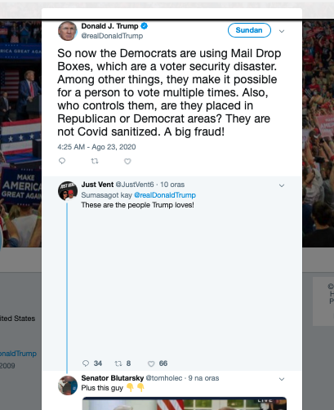
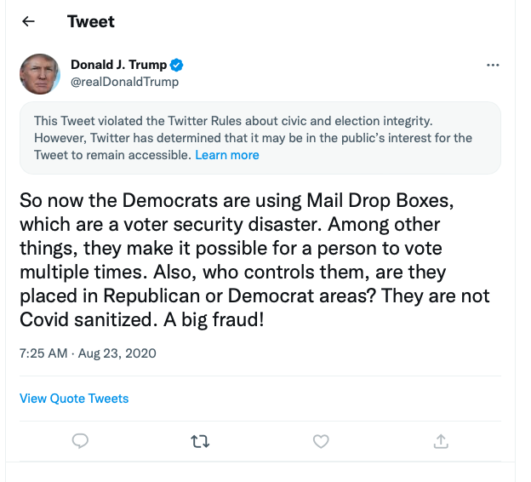
Initially, Twitter Labels Were a Feature of the New UI
No Twitter Rules Violated label
https://twitter.com/realdonaldtrump/status/1297495295266357248
https://web.archive.org/web/20200823210018/https://twitter.com/realdonaldtrump/status/1297495295266357248

Slide 8
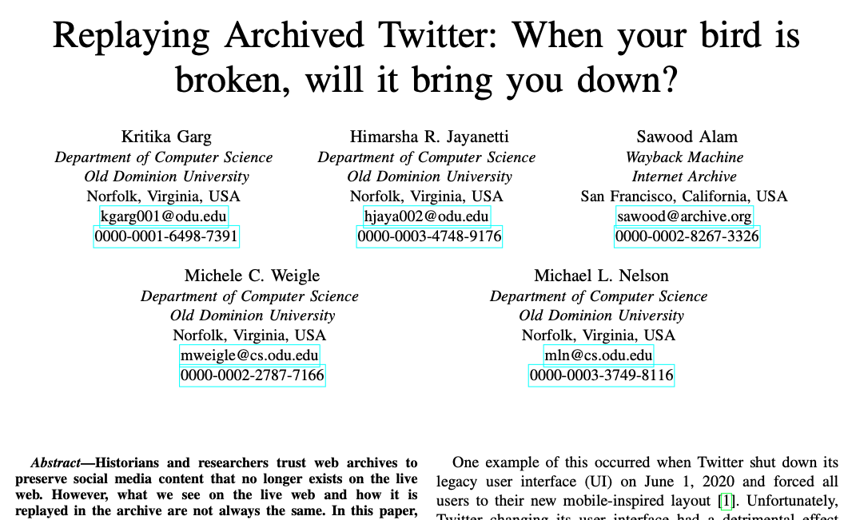
My Investigation Was Inspired by
Kritika’s & Himarsha’s Previous Study
https://arxiv.org/abs/2108.12092

Slide 9
The Dataset of Labeled Tweets Collected (476 Tweets) is Used Throughout My Study
8709 unique tweets between May 1, 2020 and January 8, 2021
https://github.com/oduwsdl/Analysing-change-in-Twitter-UI
Labeled tweets of @realDonaldTrump collected from 3 datasets
Trump Twitter Archive (https://www.thetrumparchive.com/)
Factbase (https://factba.se/trump/)
Manually collected from their previous study (twitterlabels6)
476 unique tweet IDs collected
450 “Fact-check” labeled tweets
26 “Violated Twitter Rules” labeled tweets

Slide 10
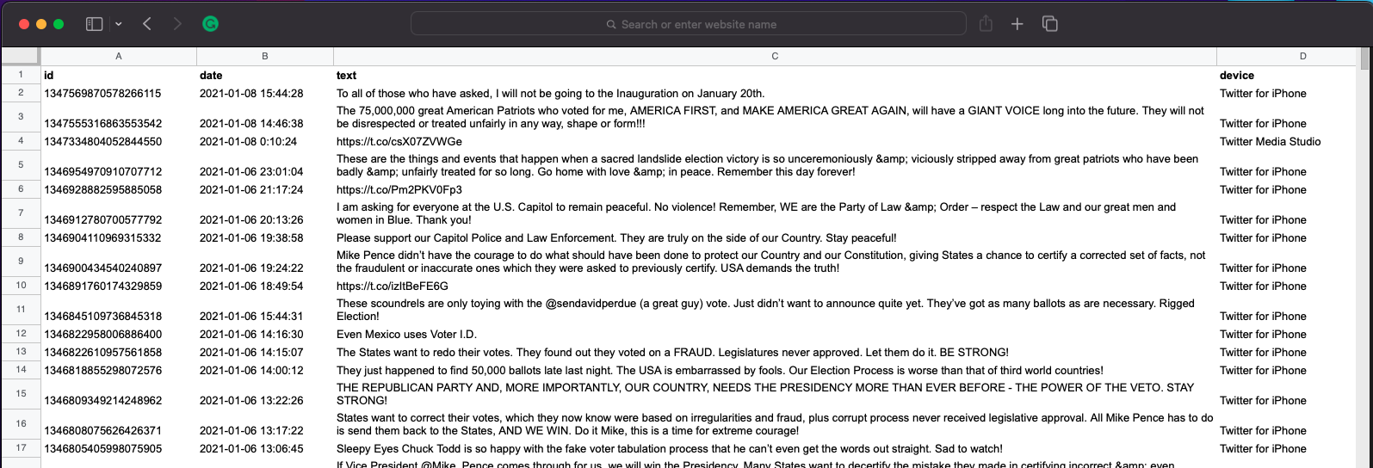
There Are Many Third-party Databases Archiving @realDonaldTrump
Trump Twitter Archive (https://www.trumptwitterarchive.site/)
56337 out of 59553 tweet data available (94.6%)
https://www.trumptwitterarchive.site/

Slide 11
Elon Musk Intervention and
Trump’s Twitter Account Reactivation
Trump announced his candidacy for the Republican Presidential nomination in 2024
Pro-Trump rioters stormed the US Capital
Elon Musk becomes Twitter’s largest shareholder
@realDonaldTrump reactivated
Jan 8
Oct 27
Nov 18
Jan 6
Apr 25
Nov 15
Nov 19
Twitter permanently blocked Trump’s Twitter account
Elon Musk becomes Twitter’s Owner and CEO
Elon Musk started a Twitter poll asking followers to vote on whether to reinstate @realDonaldTrump. 51.8% voted YES
https://en.wikipedia.org/wiki/Acquisition_of_Twitter_by_Elon_Musk
https://www.theguardian.com/us-news/2022/nov/15/donald-trump-announces-presidential-run-2024-midterms-ron-desantis
https://www.reuters.com/technology/musks-twitter-poll-showing-narrow-majority-want-trump-reinstated-2022-11-20/

Slide 12
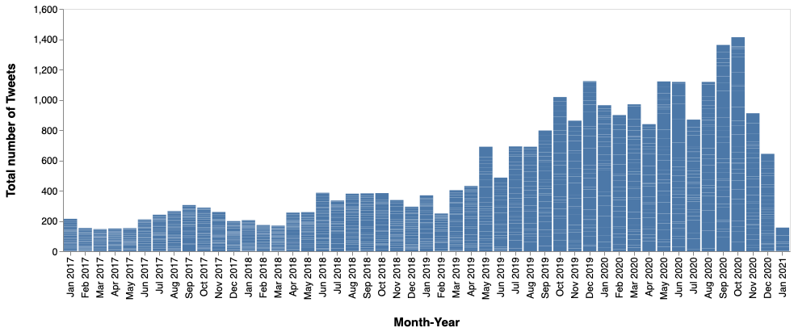
Distribution of Total Number of Tweets Over Time
(Using TweetedAt by Nauman Siddique)
2020 Presidential debates
Beginning of Trump’s tenure as the President of USA
Trump impeached
https://github.com/oduwsdl/tweetedat/blob/master/README.md
https://millercenter.org/president/trump/key-events

Slide 13
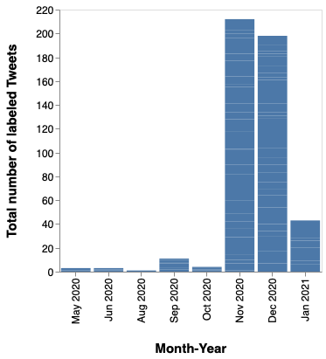
Tweets in November Were Labeled the Most
Highest number of labeled Tweets
First Fact-check labeled tweet

Slide 14
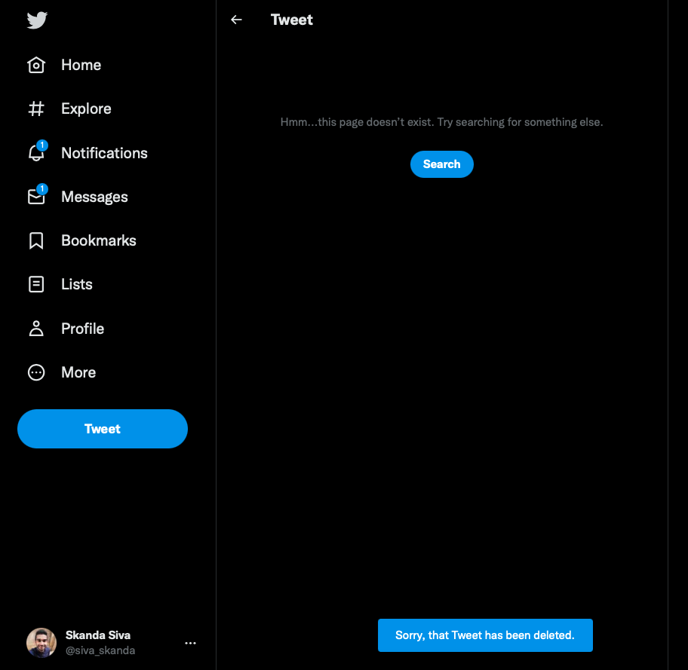
20 Tweets Are Not Available on the Live Web
Are those (450) labeled tweets still on the live web?
All of the 26 VTR labeled tweets are still present in the live-web
Out of the 450 Fact-check labels, only 430 is now available in the live web
20 Deleted Tweets!!!
https://twitter.com/realDonaldTrump/status/1335796393399775233

Slide 15

20 Tweets Are Not Available on the Live Web
Are those (450) labeled tweets still on the live web?
All of the 26 VTR labeled tweets are still present in the live-web
Out of the 450 Fact-check labels, only 430 is now available in the live web
20 Deleted Tweets!!!
https://twitter.com/realDonaldTrump/status/1335796393399775233

Slide 16
Twitter Sends a “200 OK” Response for a Tweet That Is No Longer Available (a Soft 404)
$ curl -ILs https://twitter.com/realDonaldTrump/status/1335796393399775233
HTTP/2 200
date: Mon, 05 Dec 2022 19:26:31 GMT
perf: 7626143928
expiry: Tue, 31 Mar 1981 05:00:00 GMT
pragma: no-cache
server: tsa_b
set-cookie: guest_id_marketing=v1%3A167026839173751788; Max-Age=63072000; Expires=Wed, 04 Dec 2024 19:26:31 GMT; Path=/; Domain=.twitter.com; Secure; SameSite=None
…

Slide 17
Twitter Sends an Actual 404 Instead of Soft 404 When Accessed by “GoogleBot”
$ curl -A "Googlebot" -ILs https://twitter.com/realDonaldTrump/status/1335796393399775233
HTTP/2 404
date: Mon, 05 Dec 2022 19:28:32 GMT
perf: 7626143928
expiry: Tue, 31 Mar 1981 05:00:00 GMT
pragma: no-cache
server: tsa_b
set-cookie: guest_id_marketing=v1%3A167026850898853705; Max-Age=63072000; Expires=Wed, 04 Dec 2024 19:28:32 GMT; Path=/; Domain=.twitter.com; Secure; SameSite=None
……

Slide 18
Most of the Deleted Tweets Were Tweets By Others RTd by Trump
# | Tweet ID | Tweet or RT? | Reason
1 | 1324928993594896385 | RT @dbongino | Original tweet deleted
2 | 1326740934164426752 | RT @EricTrump
3 | 1327394148098461697 | RT @jmclghln
4 | 1328328868298698754 | RT @alexbruesewitz
5 | 1328329736184078336 | RT @alexbruesewitz
6 | 1331449424690733057 | RT @Lrihendry
7 | 1331465928022822918 | RT @Lrihendry
8 | 1333616249444724737 | RT @thebradfordfile
9 | 1335463480435109888 | RT @MarkFinchem
10 | 1337421958158422017 | RT @TheRightMelissa
11 | 1338718436508241923 | RT @KanekoaTheGreat
12 | 1340716121671004161 | RT @jeasRyuu
13 | 1343646101266714624 | RT @Lrihendry
14 | 1345752835913359367 | RT @realMikeLindell

Slide 19
One of Them Was a RT of His Own Tweet and Five of Them Were Tweets Authored by Himself
# | Tweet ID | Tweet or RT? | Working URIM
1 | 1329096639651471361 | Tweet authored by him | https://web.archive.org/web/20201118161849/https://twitter.com/realDonaldTrump/status/1329096639651471361
2 | 1335796393399775233 | Tweet authored by him | https://web.archive.org/web/20201207040116/https://twitter.com/realdonaldtrump/status/1335796393399775233
3 | 1346900434540240897 | Tweet authored by him | https://web.archive.org/web/20210106193102/https://twitter.com/realdonaldtrump/status/1346900434540240897
4 | 1346928882595885058 | Tweet authored by him | https://web.archive.org/web/20210106211739/https://twitter.com/realdonaldtrump/status/1346928882595885058
5 | 1346954970910707712 | Tweet authored by him | https://web.archive.org/web/20210106230114/https://twitter.com/realdonaldtrump/status/1346954970910707712
6 | 1329097597743722496 | RT @realDonaldTrump | Original tweet deleted: 1329096639651471361

Slide 20
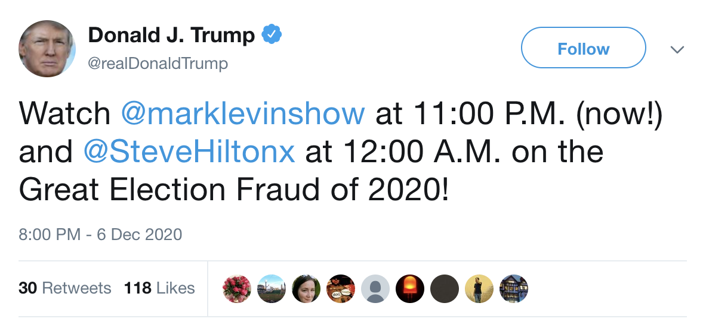

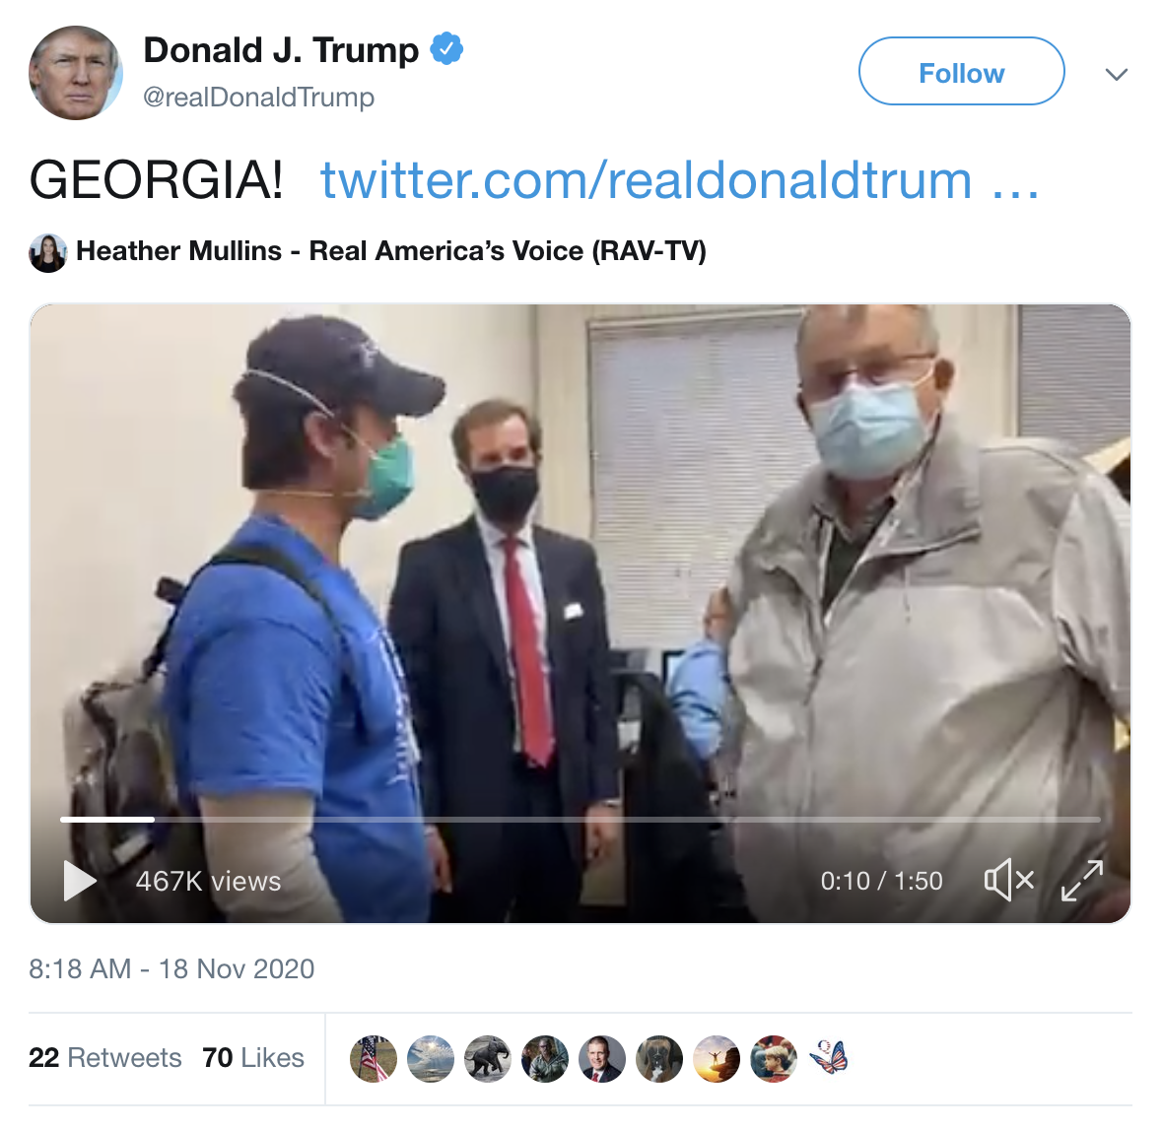
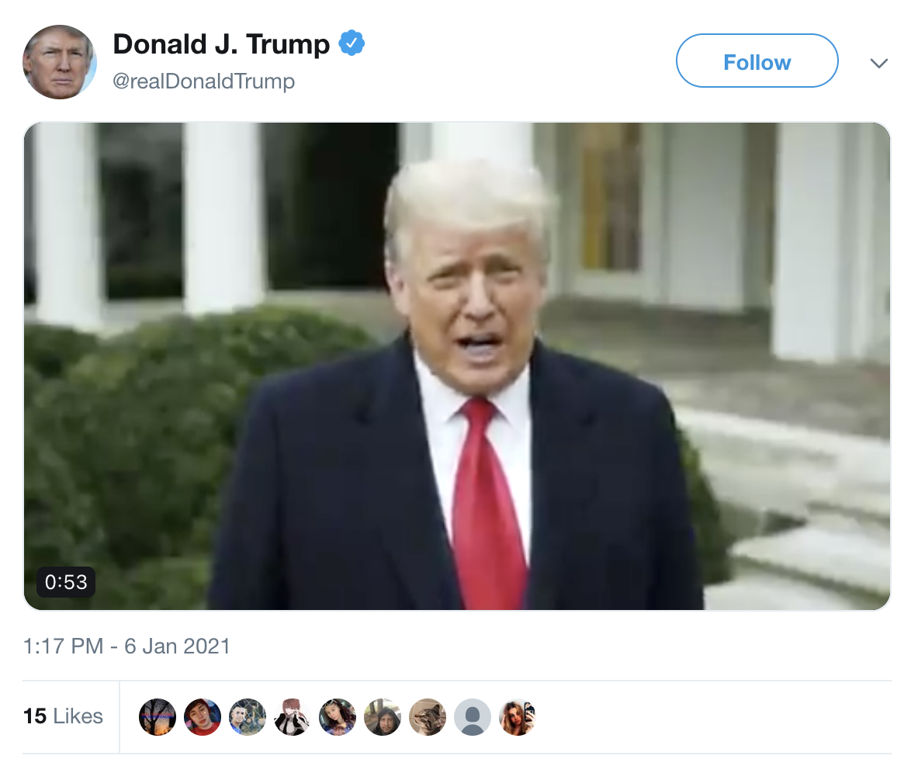
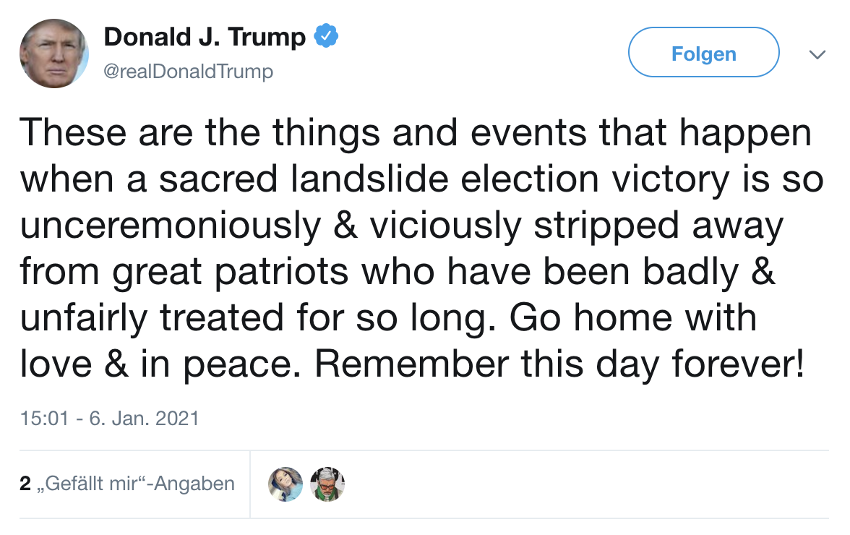
Screenshots of the Deleted Tweets
Tweeted on January 6th 2021
https://web.archive.org/web/20201207040116/https://twitter.com/realdonaldtrump/status/1335796393399775233
https://web.archive.org/web/20210106193102/https://twitter.com/realdonaldtrump/status/1346900434540240897
https://web.archive.org/web/20201118161849/https://twitter.com/realDonaldTrump/status/1329096639651471361
https://web.archive.org/web/20210106211739/https://twitter.com/realdonaldtrump/status/1346928882595885058
https://web.archive.org/web/20210106230114/https://twitter.com/realdonaldtrump/status/1346954970910707712

Slide 21
Content-Length Can Be Used to Distinguish Between
Old UI and New UI Mementos
Old UI Memento:
$ curl -ILs https://web.archive.org/web/20210107034102/https://twitter.com/realDonaldTrump/status/1325594474110726150 | grep "content-length"
content-length: 475141
New UI Memento:
$ curl -ILs https://web.archive.org/web/20210110213124/https://twitter.com/realDonaldTrump/status/1325594474110726150 | grep "content-length"
content-length: 62525
Content-Length Old UI > New UI by at least an order of Magnitude

Slide 22
Checking MemGator for Mementos in Other Web Archives
# | Web Archive | Domain | URI-Ms
 |  |  | Old UI | New UI
1 | Archive-It | wayback.archive-it.org | 1251 | 153
2 | archive.today | archive.md | 0 | 979
3 | Icelandic Web Archive | wayback.vefsafn.is | 0 | 3
4 | Internet Archive | web.archive.org | 17915 | 5409
5 | Library of Congress | webarchive.loc.gov | 886 | 702
6 | Perma.cc | perma.cc | 2 | 36
7 | Portuguese Web Archive | arquivo.pt | 42 | 47
8 | Stanford Web Archive | swap.stanford.edu | 3 | 0
9 | UK Web Archive | webarchive.org.uk | 0 | 2

Slide 23
Breakdown of Mementos Based on Three Phases:
Active, Suspended, Reinstated
Web Archive | URI-Ms
 | Active before 01/08/2020 |  | Suspended 01/09/2020 - 11/18/2022 |  | Reinstated after 11/19/2020
 | Old UI | New UI | Old UI | New UI | Old UI | New UI
Archive-It | 1033 | 50 | 213 | 98 | 5 | 5
archive.today | 0 | 966 | 0 | 3 | 0 | 10
Icelandic Web Archive | 0 | 2 | 0 | 1 | 0 | 0
Internet Archive | 12926 | 2525 | 4927 | 2771 | 62 | 113
Library of Congress | 646 | 388 | 240 | 314 | 0 | 0
Perma.cc | 1 | 29 | 1 | 7 | 0 | 0
Portuguese Web Archive | 42 | 47 | 0 | 0 | 0 | 0
Stanford Web Archive | 3 | 0 | 0 | 0 | 0 | 0
UK Web Archive | 0 | 0 | 0 | 2 | 0 | 0

Slide 24
Moving the Focus to the New UI and Labels
Web Archive | URI-Ms
 | Active before 01/08/2020 |  | Suspended 01/09/2020 - 11/18/2022 |  | Reinstated after 11/19/2020
 | Old UI | New UI | Old UI | New UI | Old UI | New UI
Archive-It | 1033 | 50 | 213 | 98 | 5 | 5
archive.today | 0 | 966 | 0 | 3 | 0 | 10
Icelandic Web Archive | 0 | 2 | 0 | 1 | 0 | 0
Internet Archive | 12926 | 2525 | 4927 | 2771 | 62 | 113
Library of Congress | 646 | 388 | 240 | 314 | 0 | 0
Perma.cc | 1 | 29 | 1 | 7 | 0 | 0
Portuguese Web Archive | 42 | 47 | 0 | 0 | 0 | 0
Stanford Web Archive | 3 | 0 | 0 | 0 | 0 | 0
UK Web Archive | 0 | 0 | 0 | 2 | 0 | 0

Slide 25
Every Working URIM for Labeled Tweets Has Also Preserved Its Labels
Label | No. of URIMs | Archive | No. of URIMs | No. of Working URIMs | Presence of Labels
FC | 118 | archive.today | 10 | 6 | 6
 |  | Archive-It | 5 | 1 | 1
 |  | Internet Archive | 103 | 44 | 44
VTR | 10 | Internet Archive | 10 | 10 | 10
Total | 128 |  | 128 | 61 | 61
Link to URIMS and status: https://docs.google.com/spreadsheets/d/1dFgawldrBbrthIBerxBtNlvZQe00WPyZmKJ_eZV1TCI/edit#gid=1086277416

Slide 26
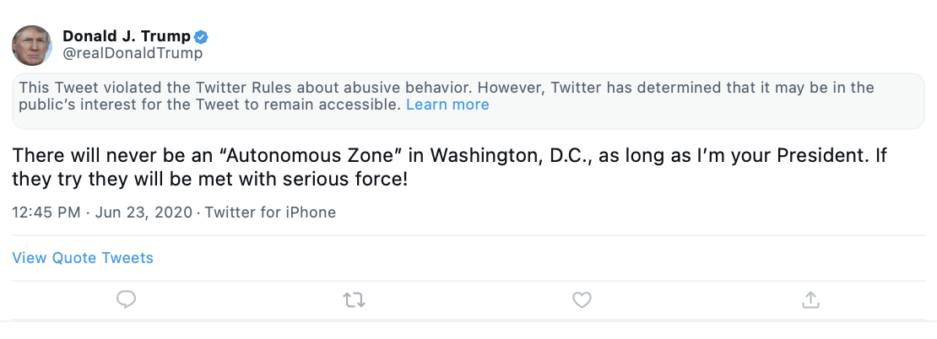
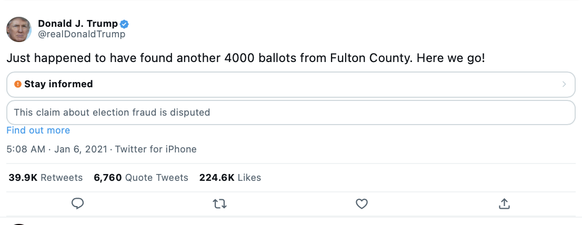
New UI Mementos With Labels - IA
Violated Twitter Rules label
Fact-check label
https://web.archive.org/web/20221120173826/https://twitter.com/realDonaldTrump/status/1266231100780744704
https://web.archive.org/web/20221124015211/https://twitter.com/realDonaldTrump/status/1346685023861272580

Slide 27
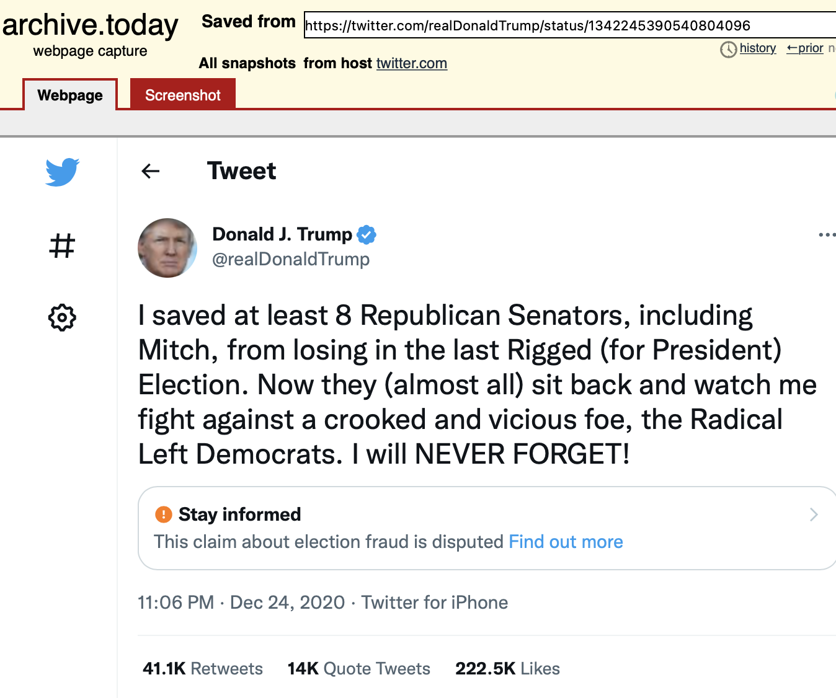
Archive.today Also Preserves the Label
Fact-check label
https://archive.ph/20221122180637/https://twitter.com/realDonaldTrump/status/1342245390540804096

Slide 28
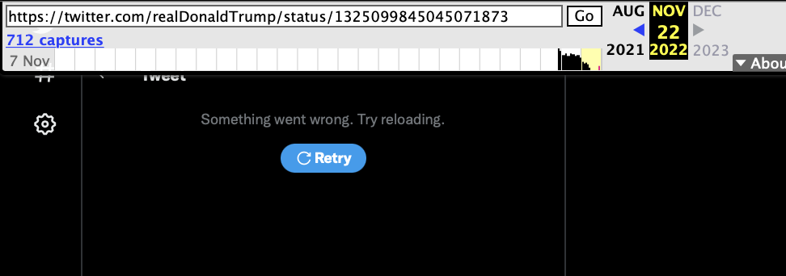
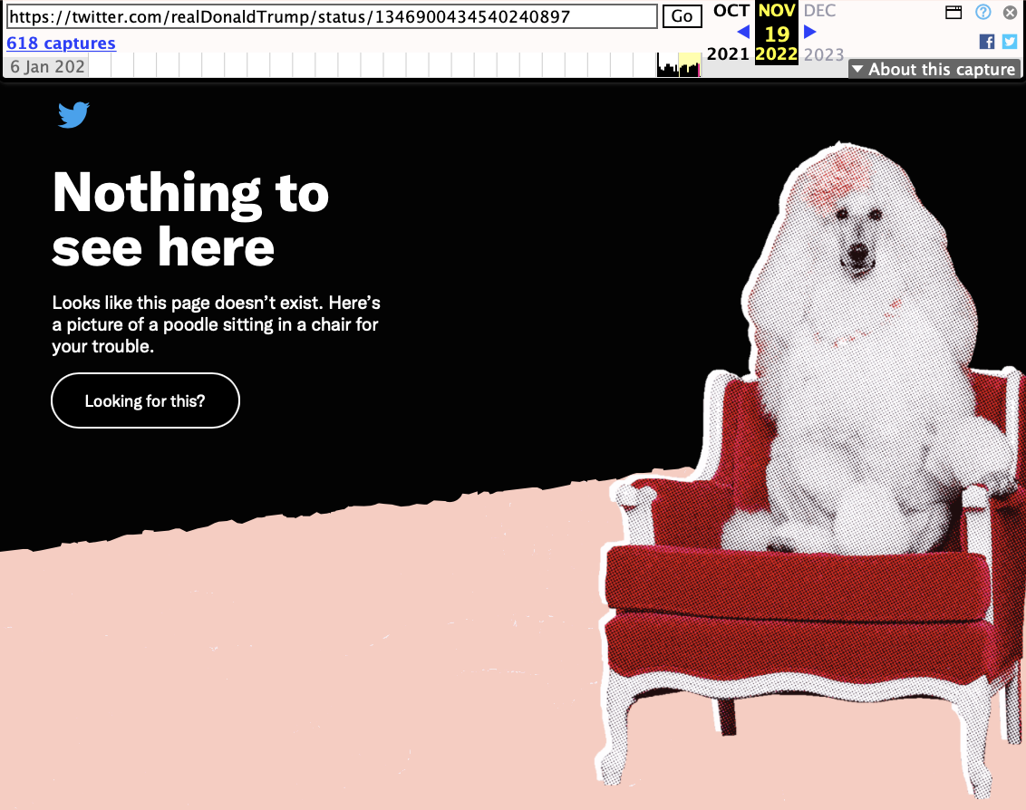
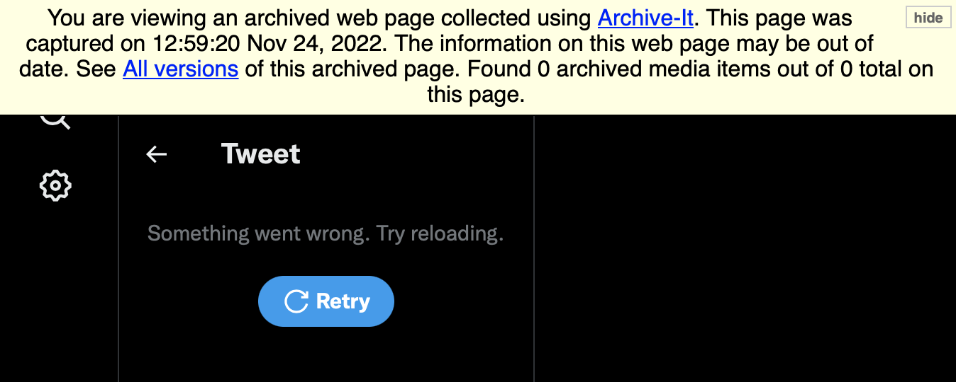
Some of the New Twitter UI Mementos Are Error Pages
Twitter error pages: Something went wrong. Try reloading
https://web.archive.org/web/20221122082246/https://twitter.com/realDonaldTrump/status/1325099845045071873
https://web.archive.org/web/20221119133813/https://twitter.com/realDonaldTrump/status/1346900434540240897
Twitter error pages: Nothing to see here (poodle picture)
https://wayback.archive-it.org/all/20221124125920/https://twitter.com/realDonaldTrump/status/1336148836495069185

Slide 29
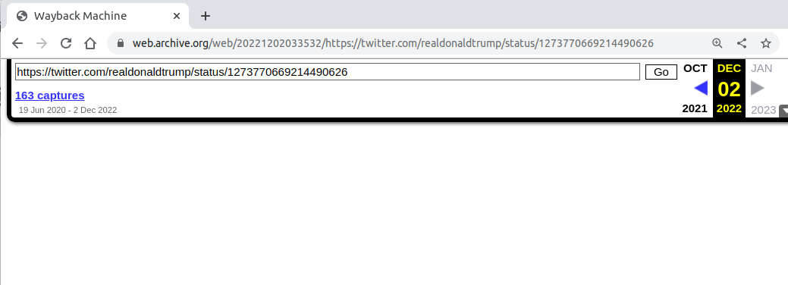
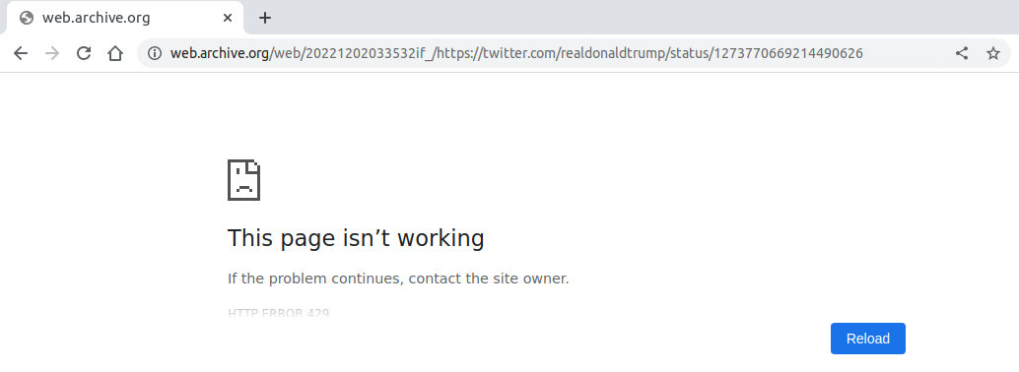
Blank URIM
https://web.archive.org/web/20221202033532/https://twitter.com/realdonaldtrump/status/1273770669214490626
https://web.archive.org/web/20221202033532if_/https://twitter.com/realdonaldtrump/status/1273770669214490626

Slide 30
Curl Request For Blank URIM
$ curl -ILs https://web.archive.org/web/20221202033532/https://twitter.com/realdonaldtrump/status/1273770669214490626
HTTP/2 200
server: nginx/1.19.5
date: Mon, 05 Dec 2022 17:32:29 GMT
content-type: text/html; charset=utf-8
server-timing: captures_list;dur=235.457428, exclusion.robots;dur=0.274055, exclusion.robots.policy;dur=0.263114, RedisCDXSource;dur=1.470774, esindex;dur=0.011384, LoadShardBlock;dur=200.208582, PetaboxLoader3.resolve;dur=185.865451, PetaboxLoader3.datanode;dur=87.653697, CDXLines.iter;dur=25.045015, load_resource;dur=112.347256
x-app-server: wwwb-app226
x-ts: 200
x-tr: 357
x-location: All
x-rl: 0
x-na: 0
x-page-cache: HIT
x-nid: -
referrer-policy: no-referrer-when-downgrade
permissions-policy: interest-cohort=()
Frame source: https://web.archive.org/web/20221202033532if_/https://twitter.com/realdonaldtrump/status/1273770669214490626

Slide 31
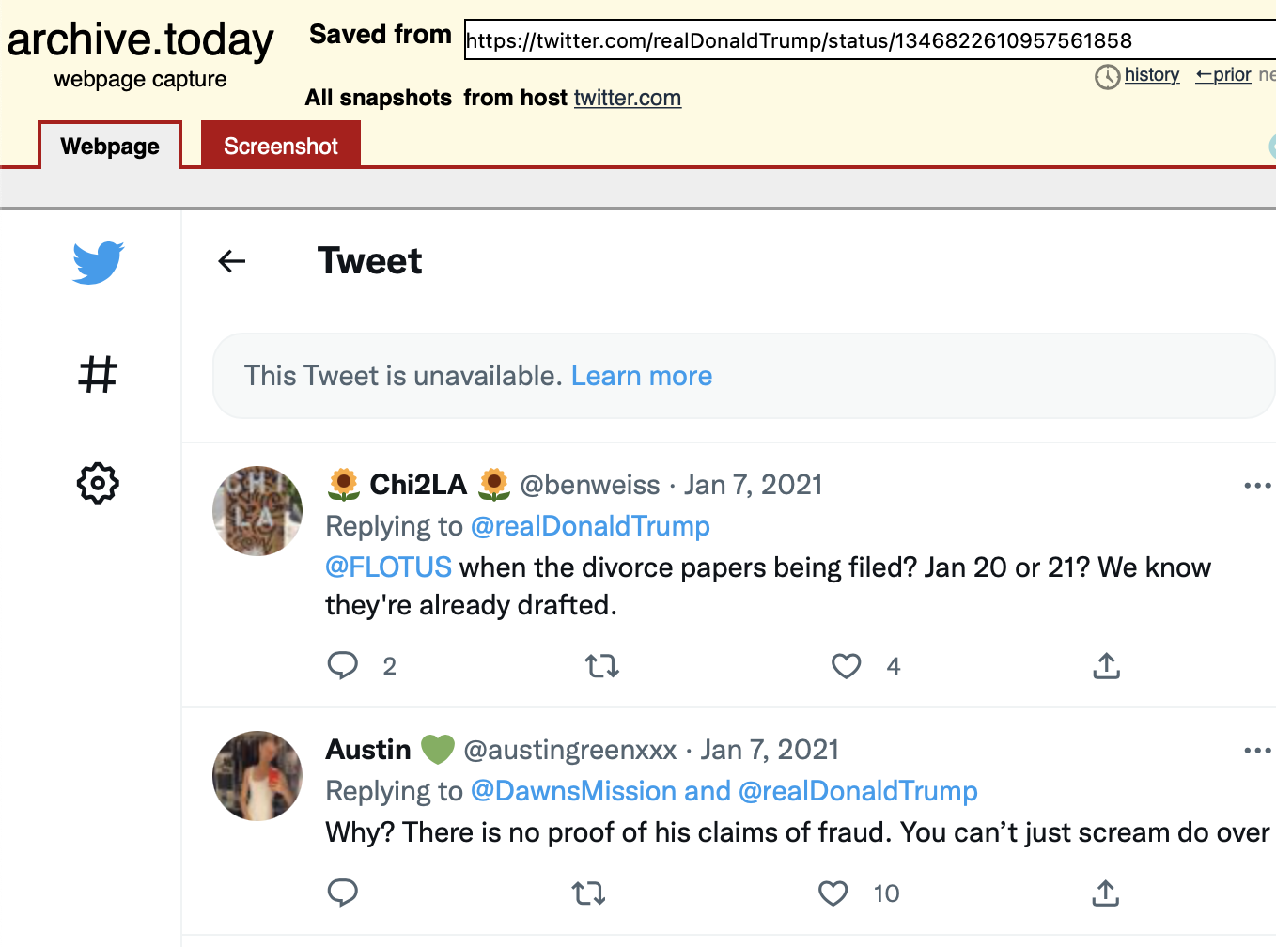
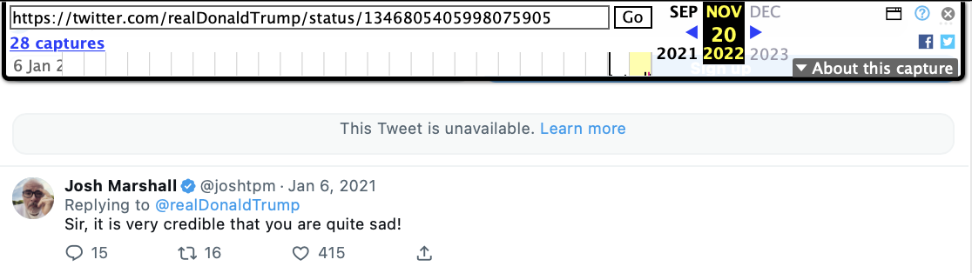
All Labeled Tweets on Nov 20th, 2022 Are Unavailable
https://web.archive.org/web/20221120025423/https://twitter.com/realDonaldTrump/status/1346805405998075905
Tweet Unavailable
https://archive.ph/20221120162551/https://twitter.com/realDonaldTrump/status/1328200072987893762
https://web.archive.org/web/20221120025423/https://twitter.com/realDonaldTrump/status/1346805405998075905
https://archive.ph/20221120162551/https://twitter.com/realDonaldTrump/status/1328200072987893762
https://archive.ph/20221120033932/https://twitter.com/realDonaldTrump/status/1346822610957561858
https://archive.ph/20221120033530/https://twitter.com/realDonaldTrump/status/1346698217304584192
https://archive.ph/20221120032954/https://twitter.com/realDonaldTrump/status/1346685023861272580

Slide 32
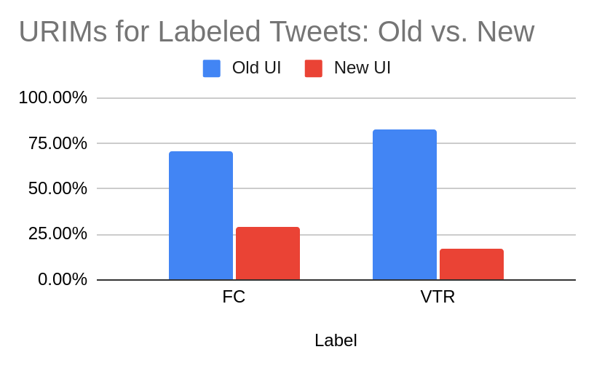
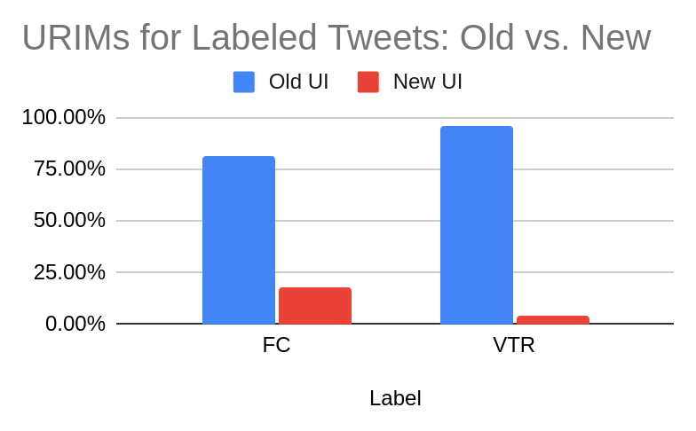
Mementos for Labeled Tweets Are Primarily of Old Twitter UI
Type of Label Tweets | MemGator (All Archives) 27430 |  | CDX (IA) 224276
 | Old UI | New UI | Old UI | New UI
FC | 70.98% | 29.02% | 81.77% | 18.23%
VTR | 83.17% | 16.83% | 95.72% | 4.28%
MemGator
CDX (IA)

Slide 33
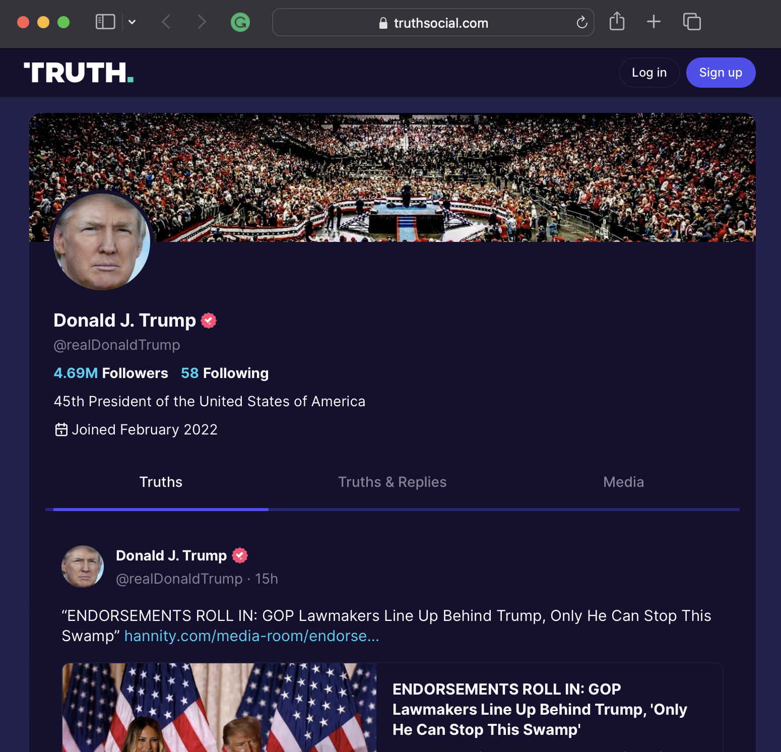
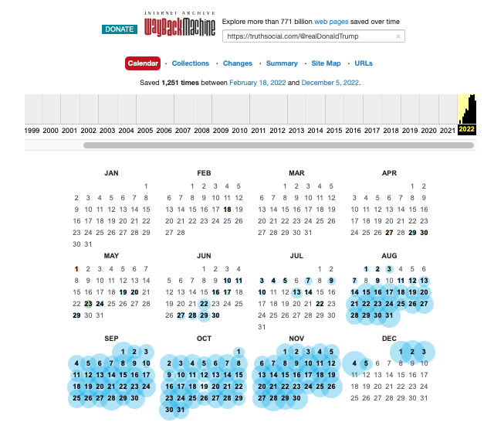
Will Trump Tweet Again?
Trump’s views
“a lot of problems at Twitter”
"I don't see any reason for it,"
Truth Media: His own Social Media
https://web.archive.org/web/20220000000000*/https://truthsocial.com/@realDonaldTrump
https://truthsocial.com/@realDonaldTrump
https://www.bloomberg.com/news/articles/2022-11-19/trump-cites-twitter-problems-says-he-ll-stick
-to-own-platform?leadSource=uverify%20wall

Slide 34
Key Takeaways
Twitter started adding labels to tweets to combat misleading information.
476 unique tweets with labels collected (previous study)
450 “Fact-check” - FC
26 “Violated Twitter Rules” - VTR
@realDonaldTrump’s tweets around the US presidential election (Nov - Dec, 2020) were labeled the most.
As of Dec 3, 2022,
All 26 VTR labeled tweets are present on the live web.
20 (out 450) FC labeled tweets are not available on the live web.
3 of 5 deleted tweets authored by him were tweeted on January 6th 2021.
It appears that web archives still continue to save its older UI mementos, most likely as a result of the challenges in preserving new Twitter UI.
Every working new Twitter UI URIM for labeled tweets has also preserved its labels.

Slide 35
Back-up slides

Slide 36
Latest URIMs for New UI, VTR Labels
All are from IA.
All are archived with the label.
https://web.archive.org/web/20221120173826/https://twitter.com/realDonaldTrump/status/1266231100780744704
https://web.archive.org/web/20221202035039/https://twitter.com/realDonaldTrump/status/1275409656488382465
https://web.archive.org/web/20221202035122/https://twitter.com/realdonaldtrump/status/1275409656488382465
https://web.archive.org/web/20221122195238/https://twitter.com/realDonaldTrump/status/1297495295266357248
https://web.archive.org/web/20221122140122/https://twitter.com/realDonaldTrump/status/1301528522582786049
https://web.archive.org/web/20221120172811/https://twitter.com/realDonaldTrump/status/1313449844413992961
https://web.archive.org/web/20221122234139/https://twitter.com/realDonaldTrump/status/1315316071243476997
https://web.archive.org/web/20221120145347/https://twitter.com/realDonaldTrump/status/1323864823680126977
https://web.archive.org/web/20221126091828/https://twitter.com/realDonaldTrump/status/1324004491612618752
https://web.archive.org/web/20221120182239/https://twitter.com/realDonaldTrump/status/1324613181466173440

Slide 37
Latest URIMs for New UI, FC Labels
Archive.md - 10
Working - all
6 - tweet and label present
https://archive.ph/20221122180637/https://twitter.com/realDonaldTrump/status/1342245390540804096
https://archive.ph/20221120034008/https://twitter.com/realDonaldTrump/status/1346659909492998146
https://archive.ph/20221120033605/https://twitter.com/realDonaldTrump/status/1346805405998075905
https://archive.ph/20221120033632/https://twitter.com/realDonaldTrump/status/1346808075626426371
https://archive.ph/20221120033634/https://twitter.com/realDonaldTrump/status/1346818855298072576
https://archive.ph/20221120032915/https://twitter.com/realDonaldTrump/status/1346845109736845318
4 tweet not present
https://archive.ph/20221120162551/https://twitter.com/realDonaldTrump/status/1328200072987893762
https://archive.ph/20221120033932/https://twitter.com/realDonaldTrump/status/1346822610957561858
https://archive.ph/20221120033530/https://twitter.com/realDonaldTrump/status/1346698217304584192
https://archive.ph/20221120032954/https://twitter.com/realDonaldTrump/status/1346685023861272580
ArchiveIt - 5
Working: 1, label is present: https://wayback.archive-it.org/all/20221120072909/https://twitter.com/realDonaldTrump/status/1346698217304584192
Something went wrong. Try reloading.- 4 https://wayback.archive-it.org/all/20221124125920/https://twitter.com/realDonaldTrump/status/1336148836495069185
https://wayback.archive-it.org/all/20221124125752/https://twitter.com/realDonaldTrump/status/1339953001847525379
https://wayback.archive-it.org/all/20221124124645/https://twitter.com/realDonaldTrump/status/1342245390540804096
https://wayback.archive-it.org/all/20221124130249/https://twitter.com/realDonaldTrump/status/1328382287331856384

Slide 38
IA - 103
Tweet available and label is present - 44
https://web.archive.org/web/20221125031124/https://twitter.com/realDonaldTrump/status/1346659909492998146
https://web.archive.org/web/20221124015211/https://twitter.com/realDonaldTrump/status/1346685023861272580
https://web.archive.org/web/20221121175123/https://twitter.com/realDonaldTrump/status/1346698217304584192
Tweet unavailable - 1
https://web.archive.org/web/20221120025423/https://twitter.com/realDonaldTrump/status/1346805405998075905
Twitter error pages
Nothing to see here (poodle picture): 27
https://web.archive.org/web/20221119133813/https://twitter.com/realDonaldTrump/status/1346900434540240897
https://web.archive.org/web/20221119082619/https://twitter.com/realDonaldTrump/status/1346928882595885058
Something went wrong. Try reloading.: 30
https://web.archive.org/web/20221122082246/https://twitter.com/realDonaldTrump/status/1325099845045071873
https://web.archive.org/web/20221128220715/http://twitter.com/realdonaldtrump/status/1327956491056279552
https://web.archive.org/web/20221120064713/https://twitter.com/realdonaldtrump/status/1328200072987893762
Blank, Archival HTTP 429 - 1
https://web.archive.org/web/20221202033532/https://twitter.com/realdonaldtrump/status/1273770669214490626

